Slide 1

CUSTOMER PREDICTION
Ayesha Nadaf ,Data Analyst Intern
11/09/2025

Slide 2
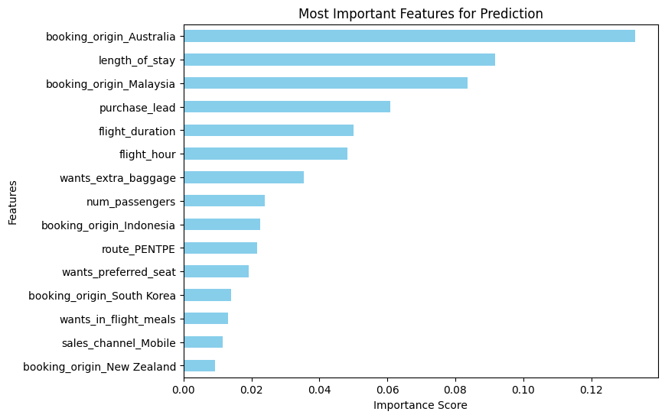
PREDICTIVE MODEL TO UNDERSTAND CUSTOMER bookings
Evaluation:
The most important variable in the model was booking_origin_Australia, showing that whether a booking originated in Australia had the strongest influence on predictions.
Other significant factors included length_of_stay, booking_origin_Malaysia, and purchase_lead, while variables such as sales_channel_Mobile and booking_origin_New Zealand contributed little to the model.
The accuracy of the model was approximately 0.74 (both test and cross-validation), indicating reasonably consistent performance across datasets. However, the model may benefit from further refinement.
I suggest incorporating more customer-centric and behavioral features to enhance predictive power.

